Slide 1
Midseason data report to reduce observer error
Megan Swan, plant ecologist, Southern Colorado Plateau Network megan_swan@nps.gov
How good are the data we’re collecting, anyway?
Notes:
I hope I’m not the only one, but this is one of those big crazy-making questions that keeps me up at night
Maybe because I mostly deal in plant cover data which people are generally skeptical about.
But the best solution I’ve found to this issue is to just quantify it.

Slide 2
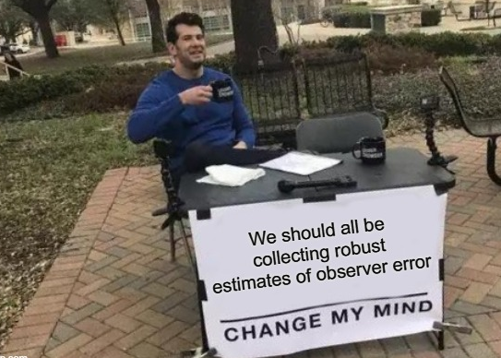
Midseason data report to reduce observer error
Notes:
Observer error exists in almost all data sets whether you are sensing, measuring, counting or estimating percent cover and I think we should all incorporate robust measurement of observer error in our protocols if at all possible.

Slide 3
Midseason data report to reduce observer error
Quantify your observer errors to:
Feed into models to improve estimates
Use as a training tool to increase consistency
Notes:
We began collecting data on observer error in 2018, Initially with the idea to use it in analyses.
But recently I wondered if it could also be used midseason as a training tool to increase consistency in real time.
I’m going to share what I came up with, and I’m curious if others are doing some similar or better.
But First you need to know a little bit about how we collect this dataset.

Slide 4
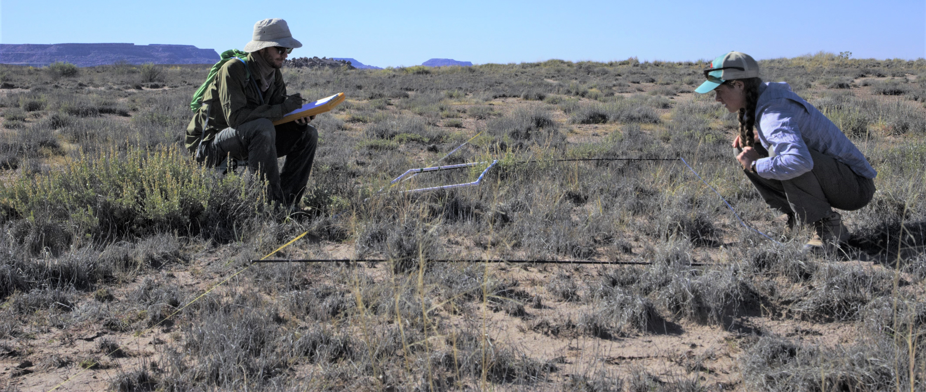
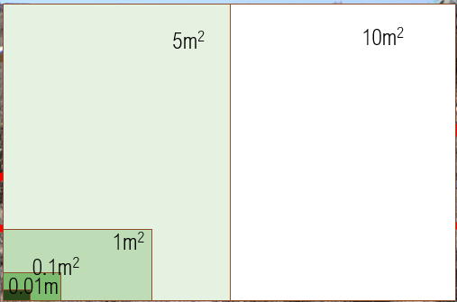
Midseason data report to reduce observer error
1 quadrat repeated by a different team to assess rates of observer error
15 quadrats per plot
Notes:
There are basically two elements. First are those visual estimates of percent cover of vegetation in 10m2 quadrats. We estimate percent foliar cover in tenths of a percent for cover of things with less than 1% and in 1% increments thereafter.
The second part we call nested frequency. There are 4 smaller quadrats nested within the 10m2 quadrat and we record the smallest quadrat size in which a species occurs. You can imagine more common species occur in smaller quadrats, less common only in the larger ones.
Our crew samples 15 of these quadrats in each plot, collecting both nested frequency and percent cover.
And then, to quantify observer error, a different set of observers repeats the sampling of just one randomly selected quadrat for each plot.

Slide 5
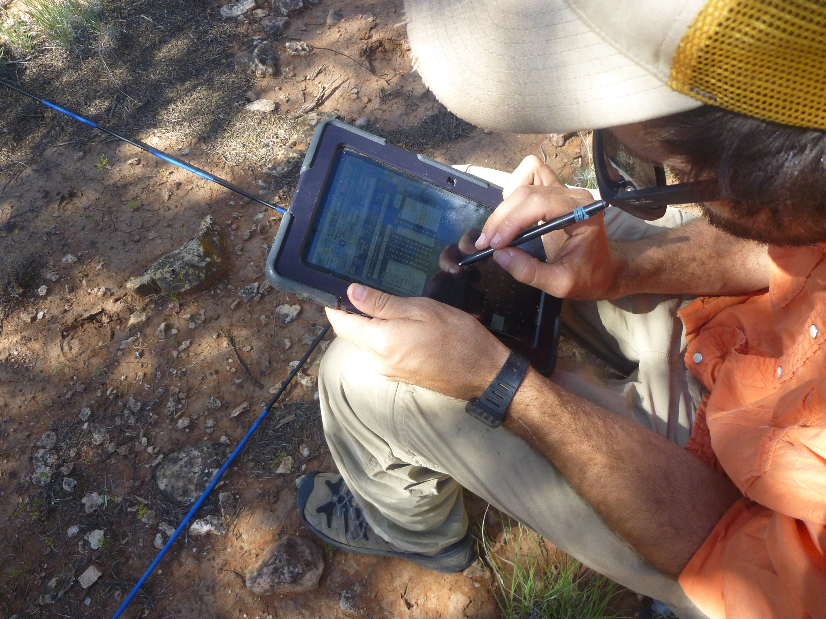
Midseason data report to reduce observer error
Notes:
And one other note: In order for these midseason error reports to come together, we needed a little sorcery to merge the individual tablet data easily (previously we only did this through r at the end of the field season and it was pretty time consuming). Cindy Parker created an access front end tool for that. After that, it was just afternoon of scripting in R.

Slide 6
Midseason data report to reduce observer error
Notes:
So I’m using these reports both for real time assessment of the data to look for errors I’d typically find only during QA/QC at the end of the season
and I’m presenting the data back to the field crews via an email before they go back out to collect more data-- with the idea that it not only gives them experience interpreting data and increases buy in, but also lets them evaluate how they are doing with consistency and accuracy and make tweaks if necessary.
So let me open this up.
The next step would be to quantify whether this reporting is actually effecting observer errors, but I’m not sure when I’ll have time to look at that, but hopefully it demonstrates some utility of taking the time to collect data on our observer errors and how important that data can be for multiple uses, both at the time collected and later.

